Slide 1
Lending Club
Predicting Interest Rate
Edward Eustachon
Shane Kok
Hannah Ho
Katherine Zingerman
Mohini Agarwal

Slide 2
Agenda
Background Information
Project Goal
Models:
Simple / Multiple Linear Regression
Polynomial Regression
KNN
Ridge Regression
Lasso
Decision Trees
Random Forest
Boosting
Key Takeaways

Slide 3

Background Information
Lending Club
Kickstarter for loans
Facilitates crowdsourced peer-to-peer microloans
Algorithm rates loans A-E
Provides interest rate based on borrower quality, probability of default, etc

Slide 4
Data Summary
Lending Club predictors:
Loan Amount
Loan Term
Annual Income
FICO Score
Public Recorded Bankruptcies
Employment length
Response Variable:
Loan Interest Rate

Slide 5
Project Goal
Identify the model that best determines the predictors that accurately explain a loan’s interest rate

Slide 6
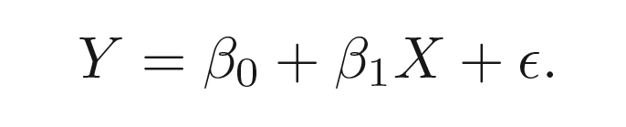
Simple Linear Regression
Process of model:
Find the coefficients of all predictors to determine its effect on the predicted output
Standard equation:
β0 = intercept
βp-1 = coefficient (weight of variable)
ε = random noise

Slide 7
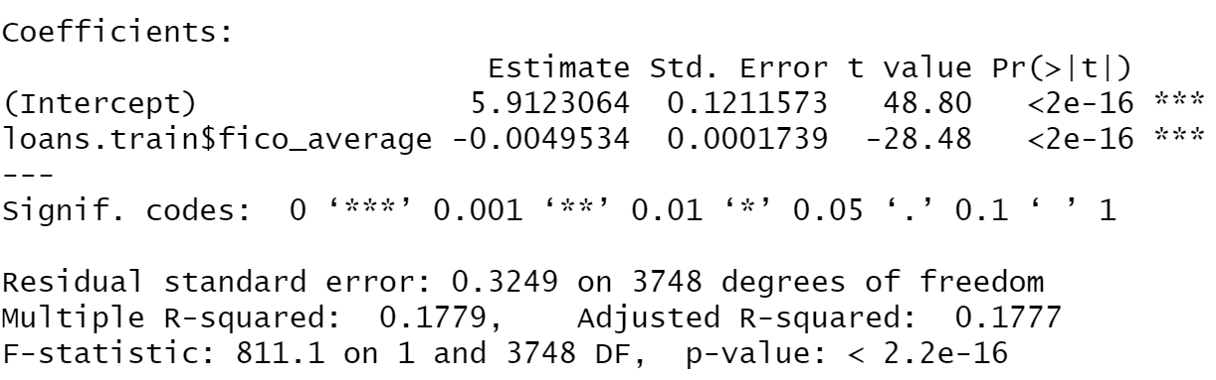
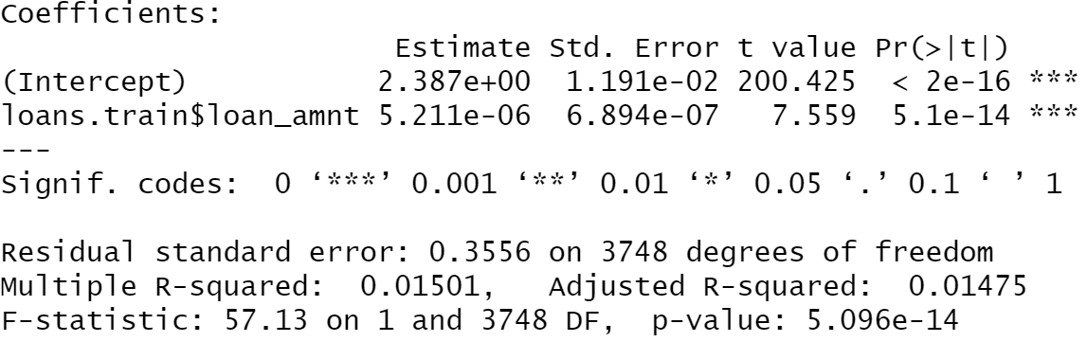
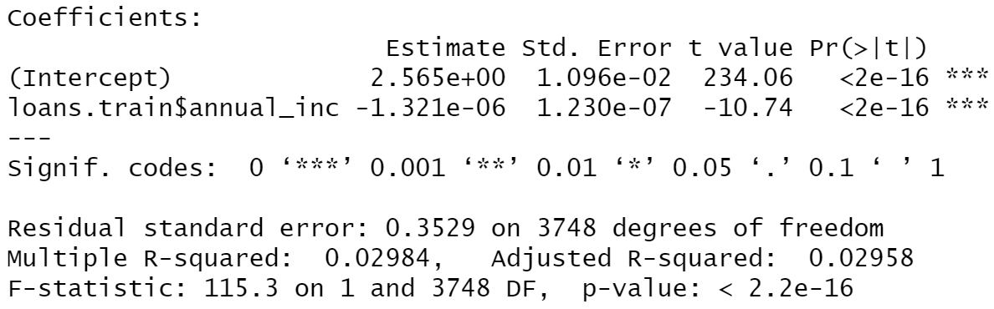
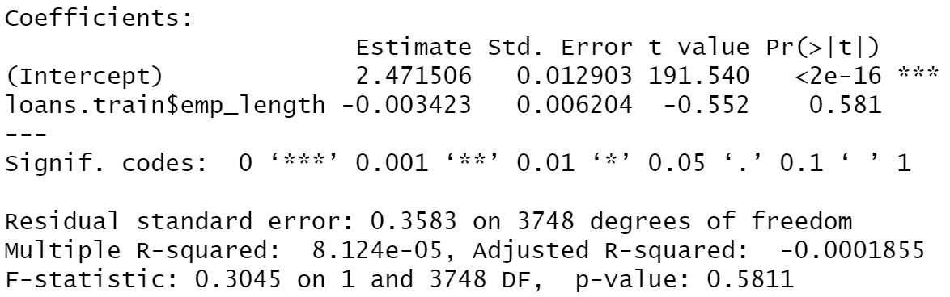
Simple Linear Regression: Coefficients
The variable that has the largest effect on the output is FICO SCORE
The RMSE is 0.386

Slide 8
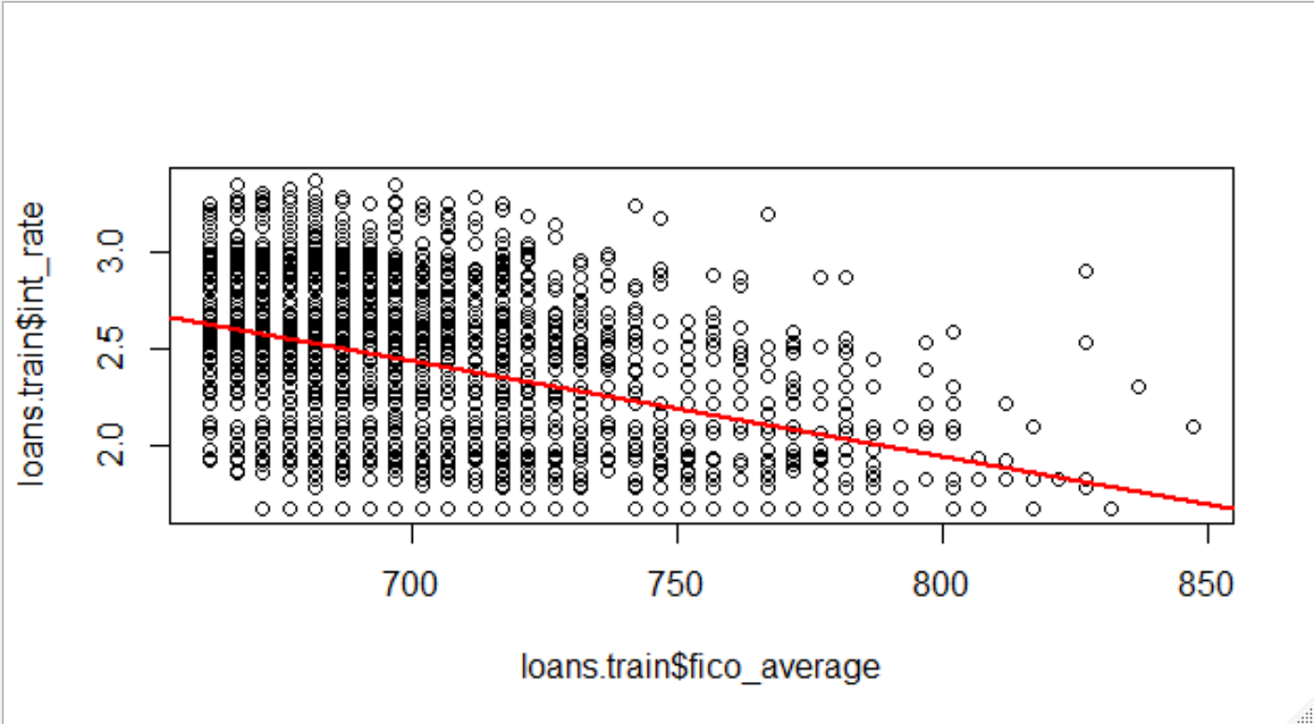
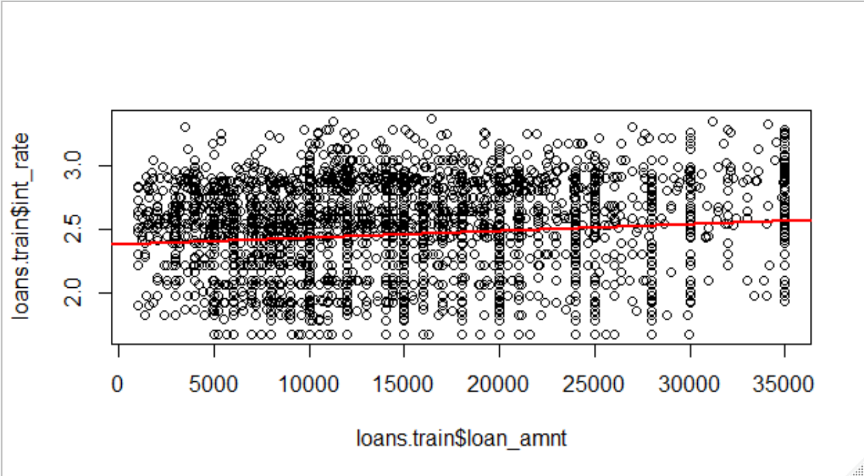
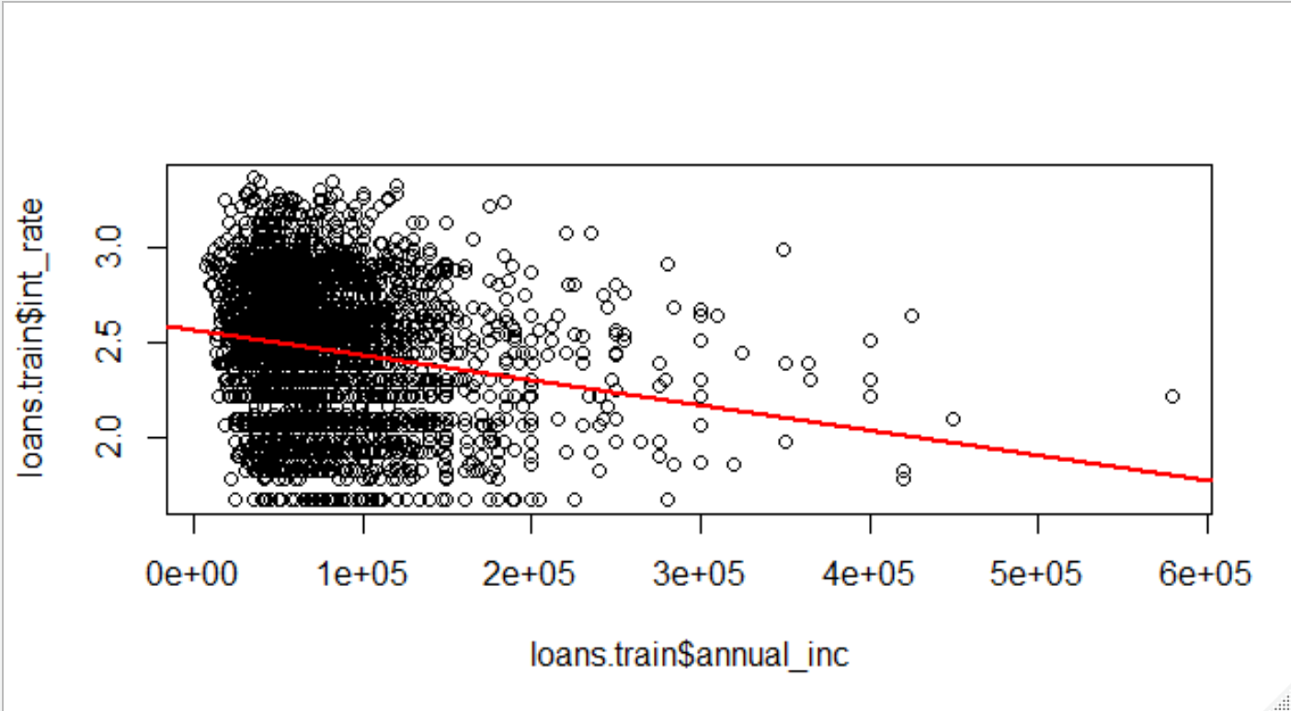
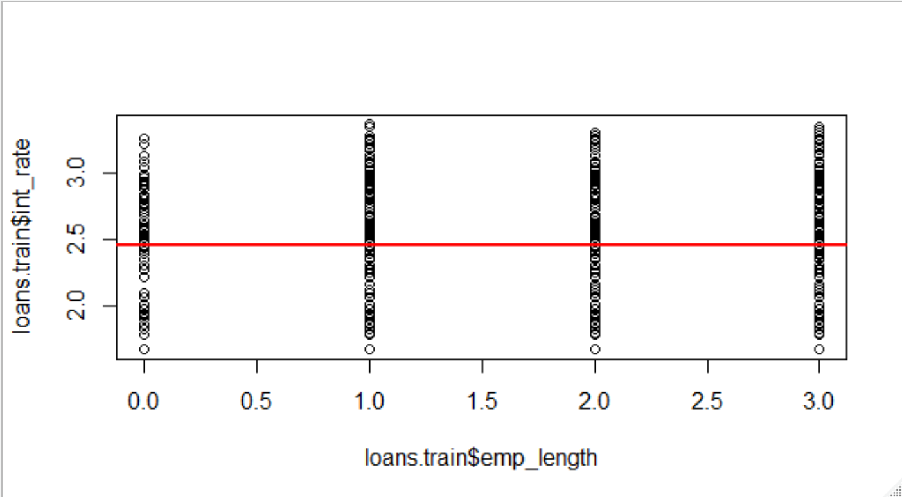
Simple Linear Regression: Best Fit Scatter-plot
The red line in each graph is the line of best fit for each model

Slide 9
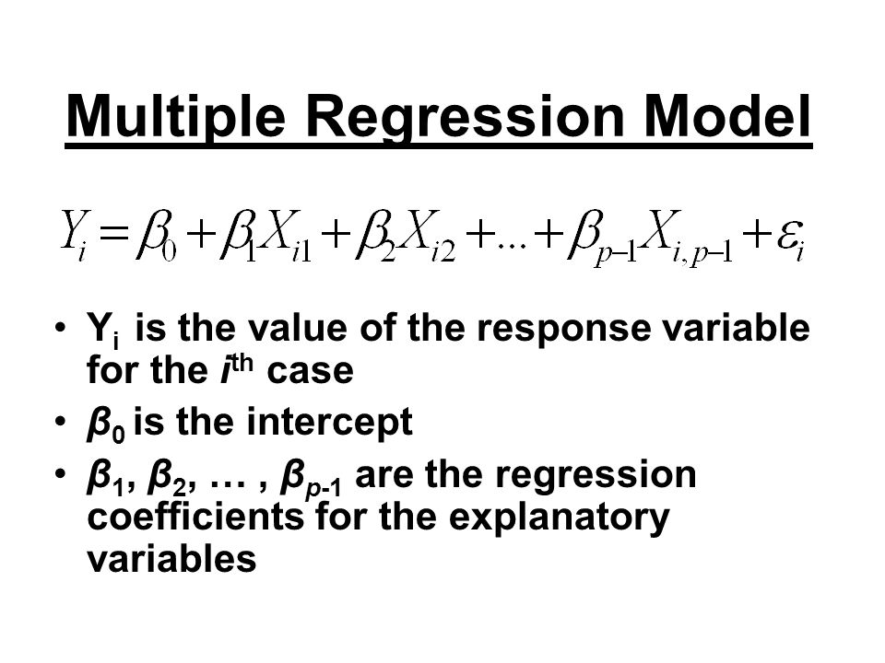
Multiple Linear Regression
Process of model:
Find the coefficients of each predictor to determine the weight of each coefficient to analyze the total effect of each variable on the predicted output
Standard equation:
β0 = intercept
βp-1 = coefficient (weight of variable)
ε = random noise

Slide 10
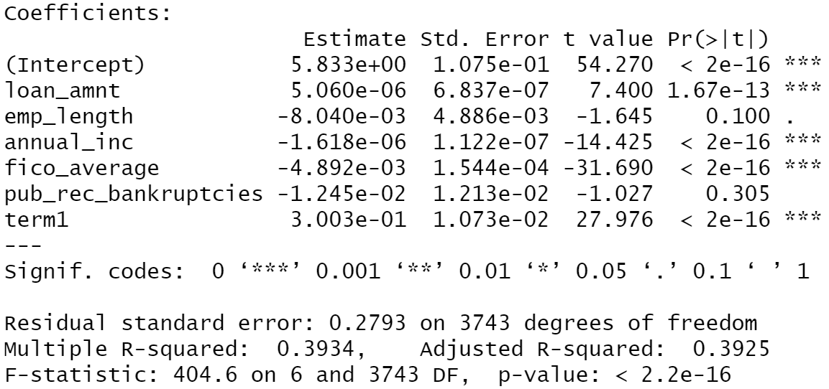
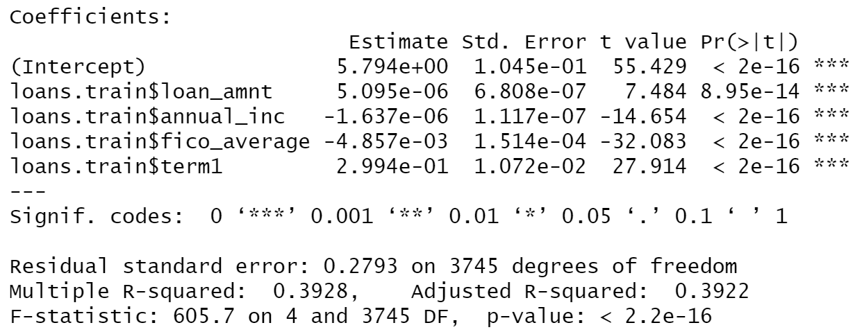
Multiple Linear Regression: Coefficients
The variable that has the largest effect on the output is FICO SCORE
The RMSE is 0.2793

Slide 11
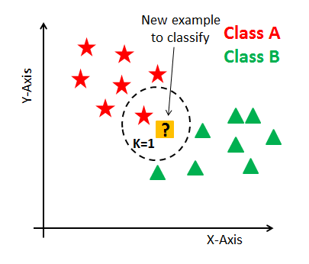
K-Nearest Neighbors
Process of knn model:
Find the optimal k
k is the number of similar points adjacent to chosen x-value that will predict the desired y value

Slide 12
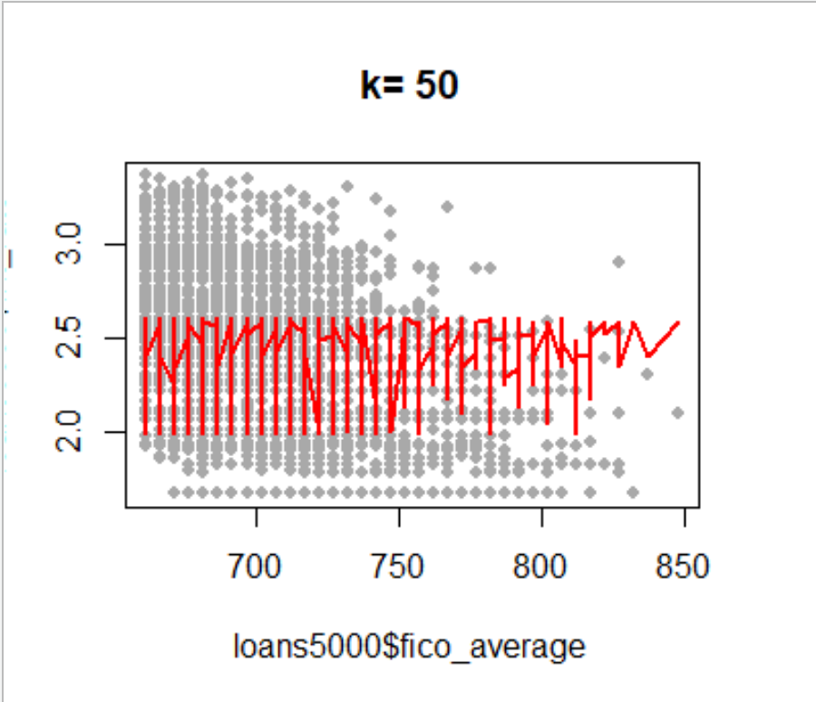
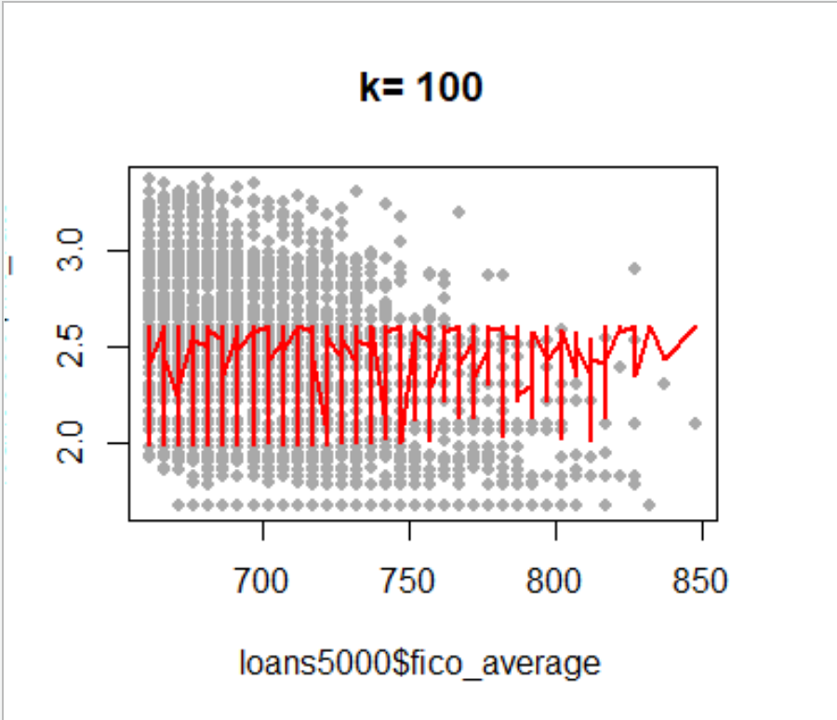
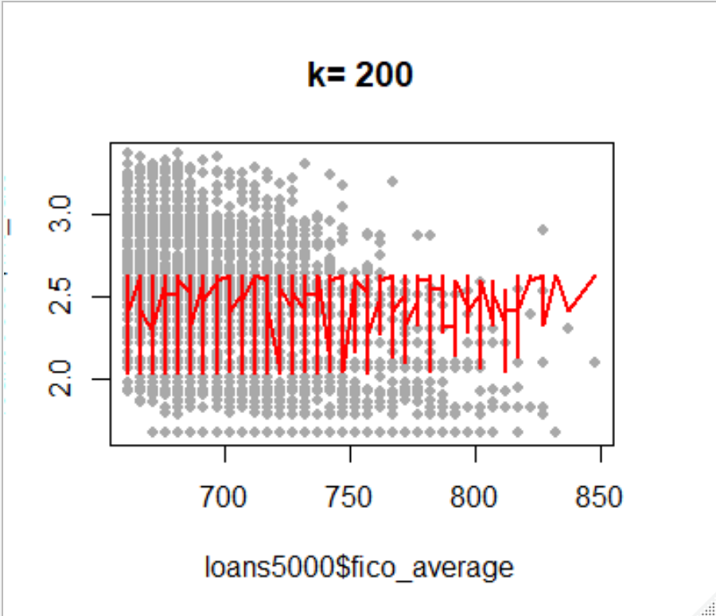


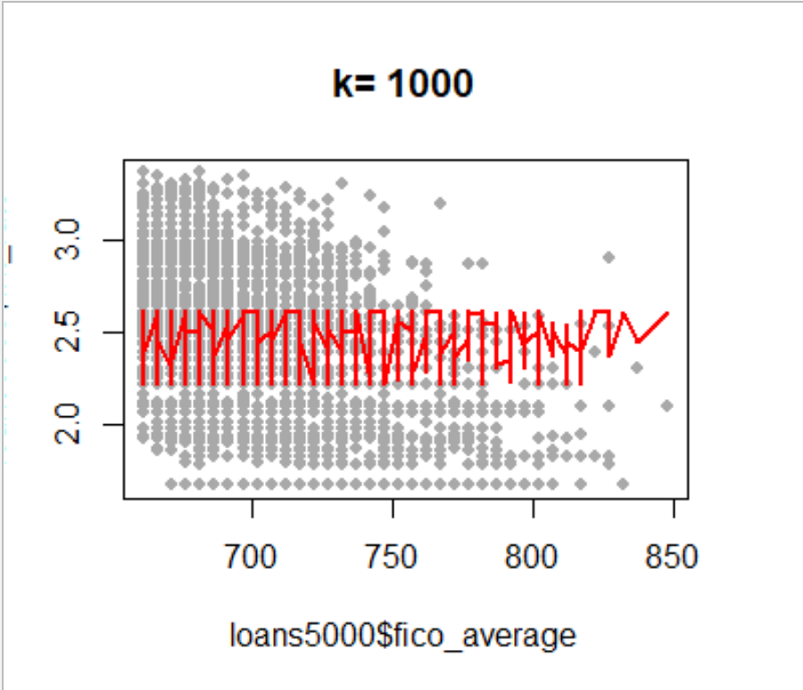
K-Nearest Neighbors: Optimal K

Slide 13
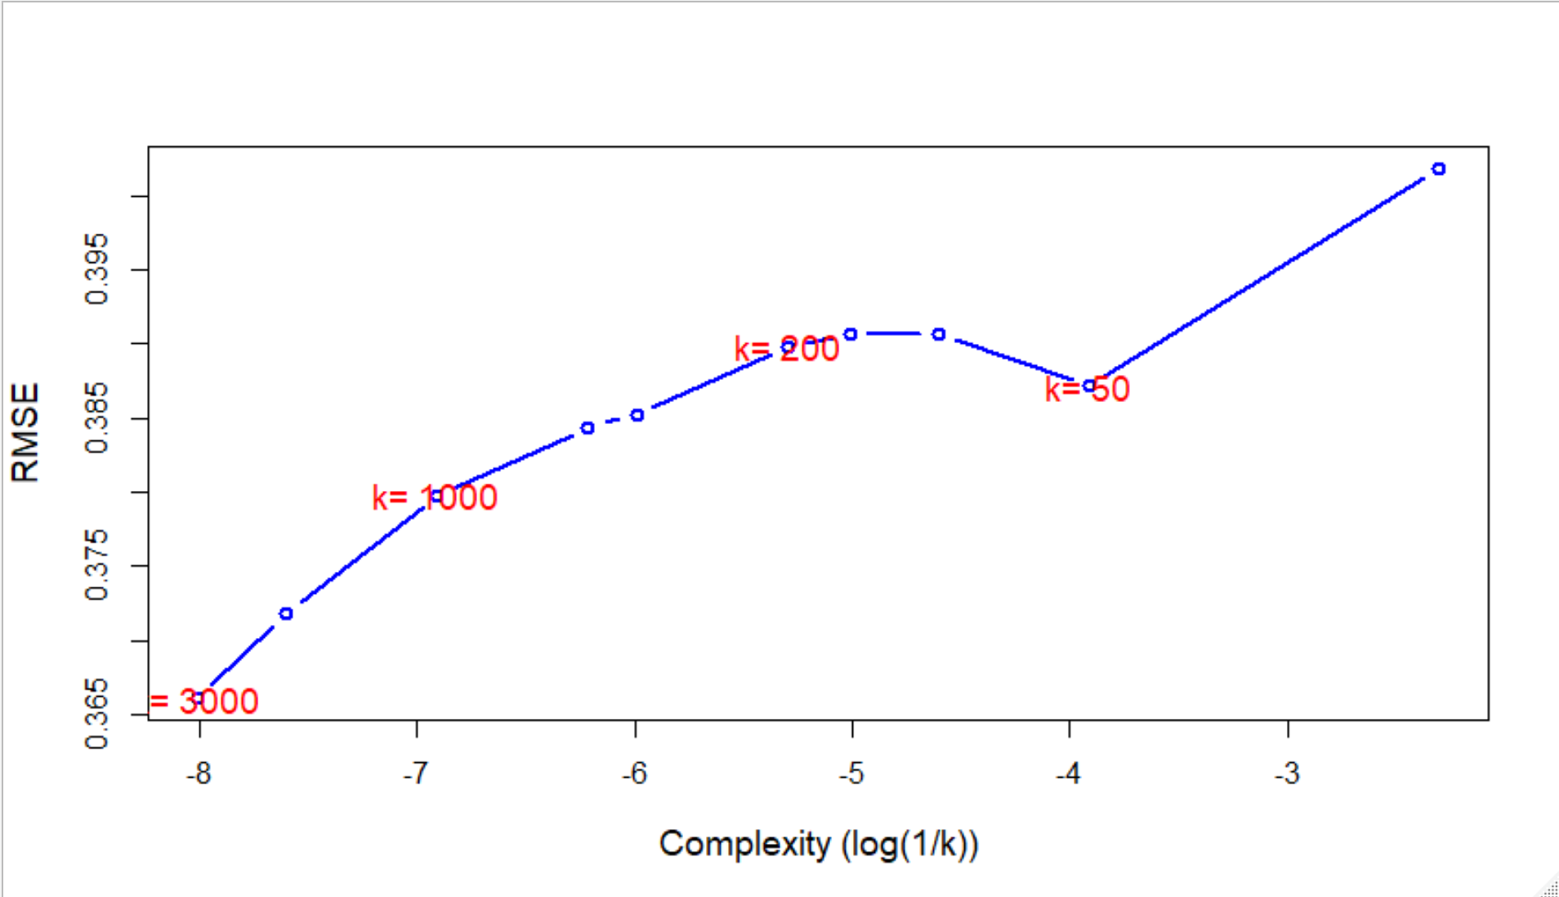
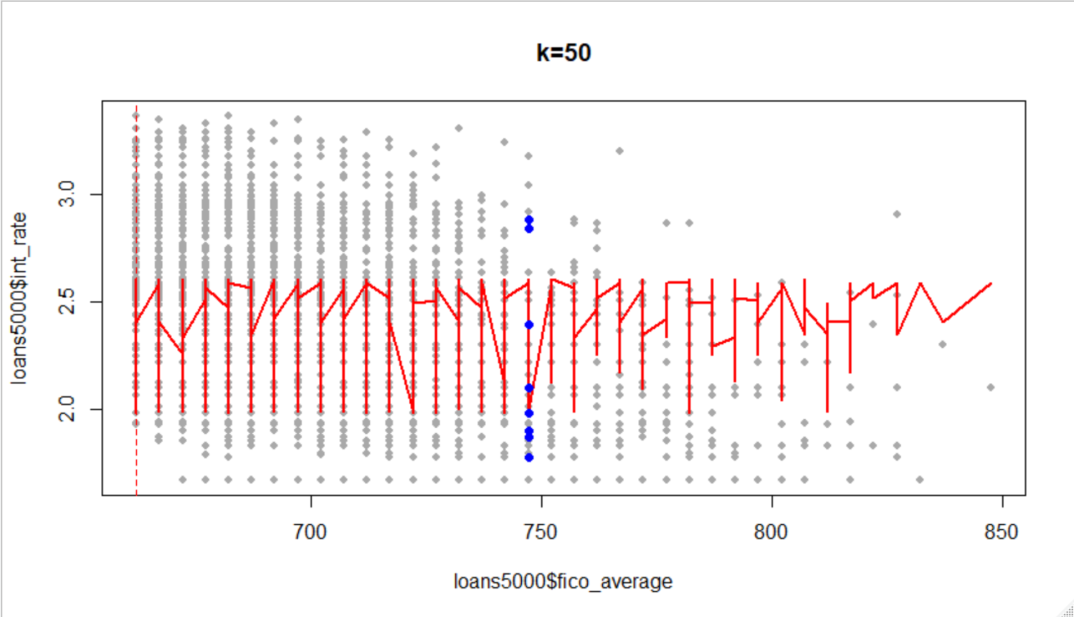
K-Nearest Neighbors: Optimal K
The optimal value of k was k=50
The second graph shows the most accurate points that must be chosen to predict the output

Slide 14
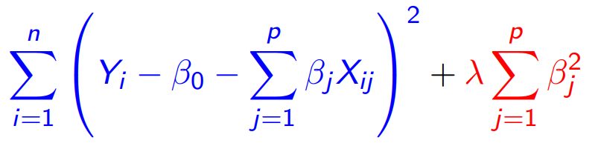
Ridge Regression
Key goal and process of model:
Adjust coefficients of predictors based on their correlation with the response
Find optimal lambda value to minimize variability and bias

Slide 15
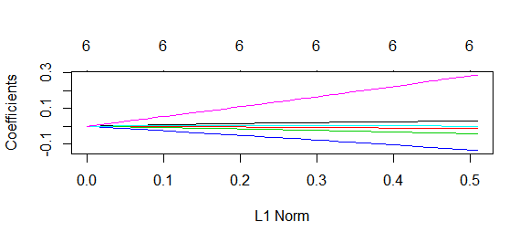
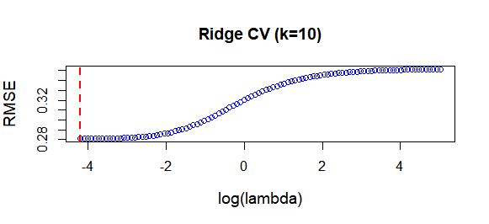
Ridge Regression: Lambda
No coefficients are zero except at lambda=0
Lambda 1SE = 0.01523
RMSE=0.2755768
Notes:
Black line is int rate - how to remove???????

Slide 16
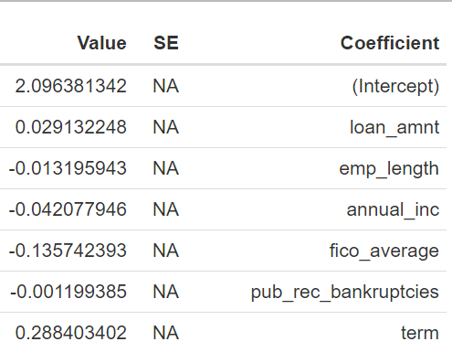
Ridge Regression: Coefficients
All coefficients near zero
Term and fico scores explain the most variation in interest rates
Notes:
0.096
library(coefplot)
library(formattable)
CV.R = cv.glmnet(Loan[tr,], logint[tr],alpha=0)
R.coeff = extract.coef(CV.R)
R.coeff
formattable(R.coeff)

Slide 17

Lasso Model
Key goal and process of model:
Zero out coefficients of predictors if their correlations with the response is low
Find optimal lambda value to minimize variability and bias

Slide 18
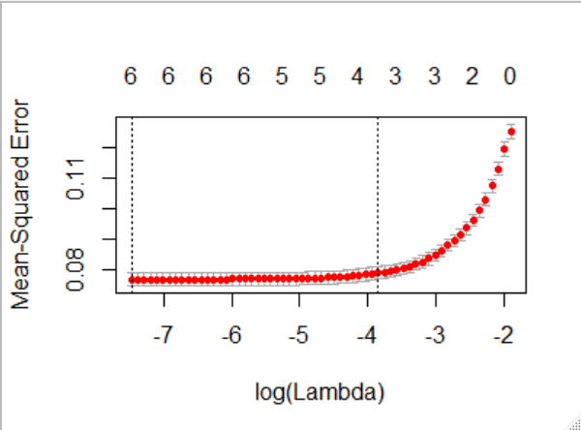
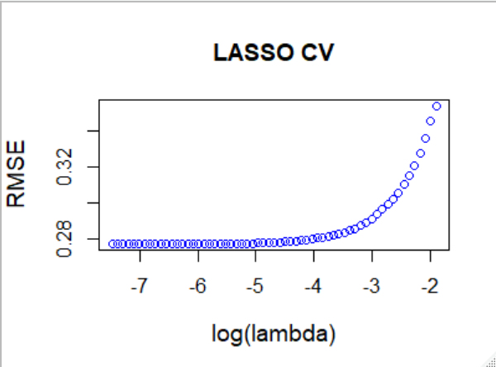
Lasso Model
Lambda Min= 0.0005679
RMSE=0.2875247

Slide 19
Lasso Model
Predictors | Coefficients
Intercept | 2.0917
Loan Term | 0.2862
Loan Amount | -
Employment Length | -
Annual Income | -0.0384
FICO Average | -0.1232
Public Record Bankruptcies | -
Predictors that got zeroed out:
Loan Amount
Employment Length
Public Record Bankruptcies
Coefficients that best predict the interest rates:
Loan Term
FICO Average

Slide 20
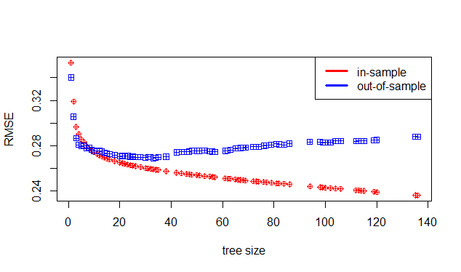

Decision Trees
Model Process:
Fit one decision tree to the data and prune with various α values
Each α value will produce tree of various sizes
The trees produced are by optimizing the function
Results: Initial tree: 136 terminal nodes
Pruned model: 33 terminal nodes Best model RMSE: 0.269

Slide 21
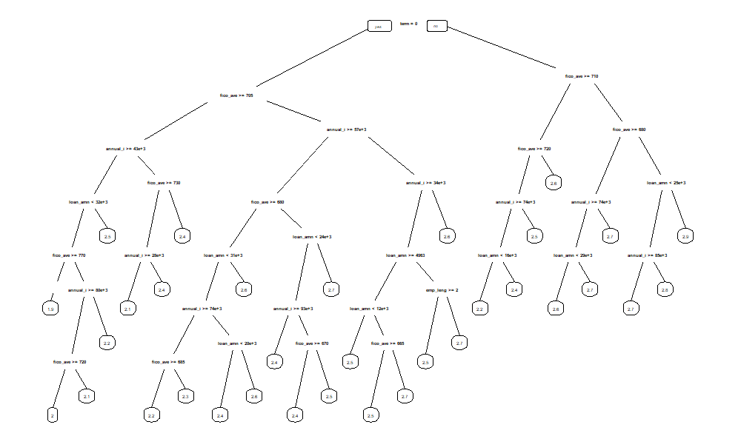
Decision Trees: Output Tree

Slide 22
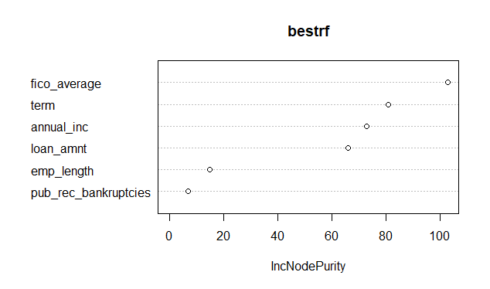
Random Forest and Bagging
Model Process:
Fit a random forest model to bootstrap samples with various tuning parameter values
B = 100 and B = 500 bootstrap samples → Number of trees aggregated
m = sqrt(6) and m = 6 variables at each split
Result:
Optimal parameters: B = 500 and m = sqrt(6) Minimum RMSE = .267

Slide 23
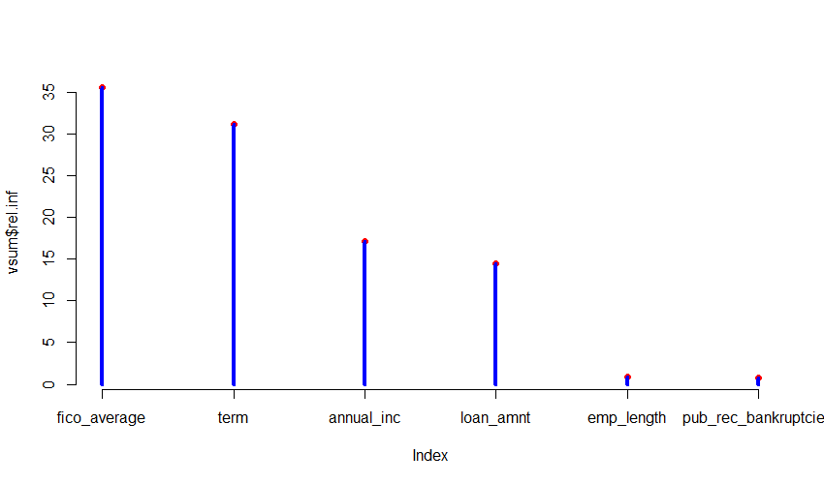
Boosting
Model Process:
Fit boosting ensemble with varying depth, number of trees, and lambda
λ = .0001 and λ = .2
D = 4 and D = 10
B = 1000 and B = 5000
Result:
Optimal parameters: λ = .0001 D = 10 B = 5000 Minimum RMSE = .261

Slide 24
Key Takeaway: Comparison of Models
MODEL | Regression | KNN | Ridge | LASSO | Tree | RF | Boosting
RMSE | 0.281 | 0.368 | 0.276 | 0.275 | 0.278 | 0.272 | 0.267
Boosting has the lowest RMSE and is therefore the best model to predict interest rate given the included features

